Slide 1
Linear Algebra

Slide 2
Dimensionality
We like to think in two or three dimensions

Slide 3
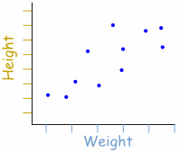
How Many Dimensions of Data?

Slide 4
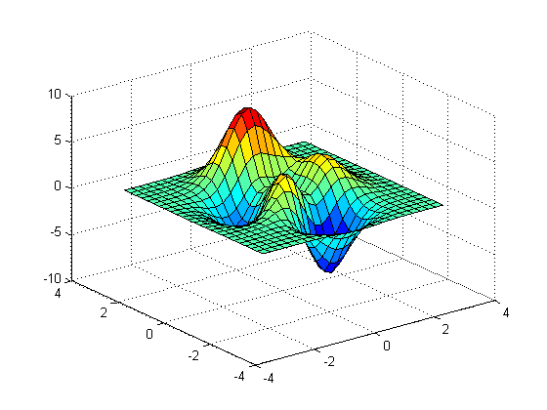
How Many Dimensions of Data?

Slide 5
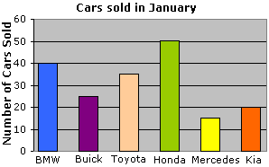
How Many Dimensions of Data?

Slide 6
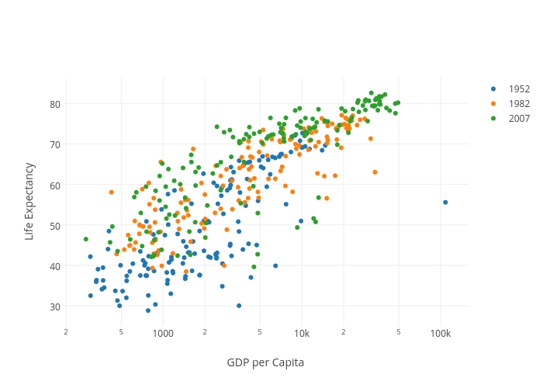
How Many Dimensions of Data?

Slide 7
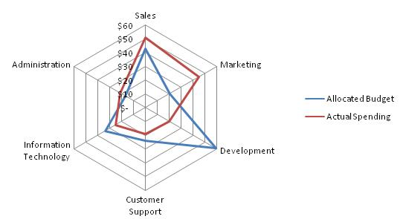
How Many Dimensions of Data?

Slide 8
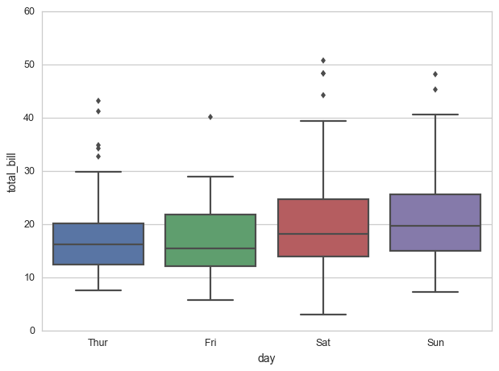
How Many Dimensions of Data?

Slide 9
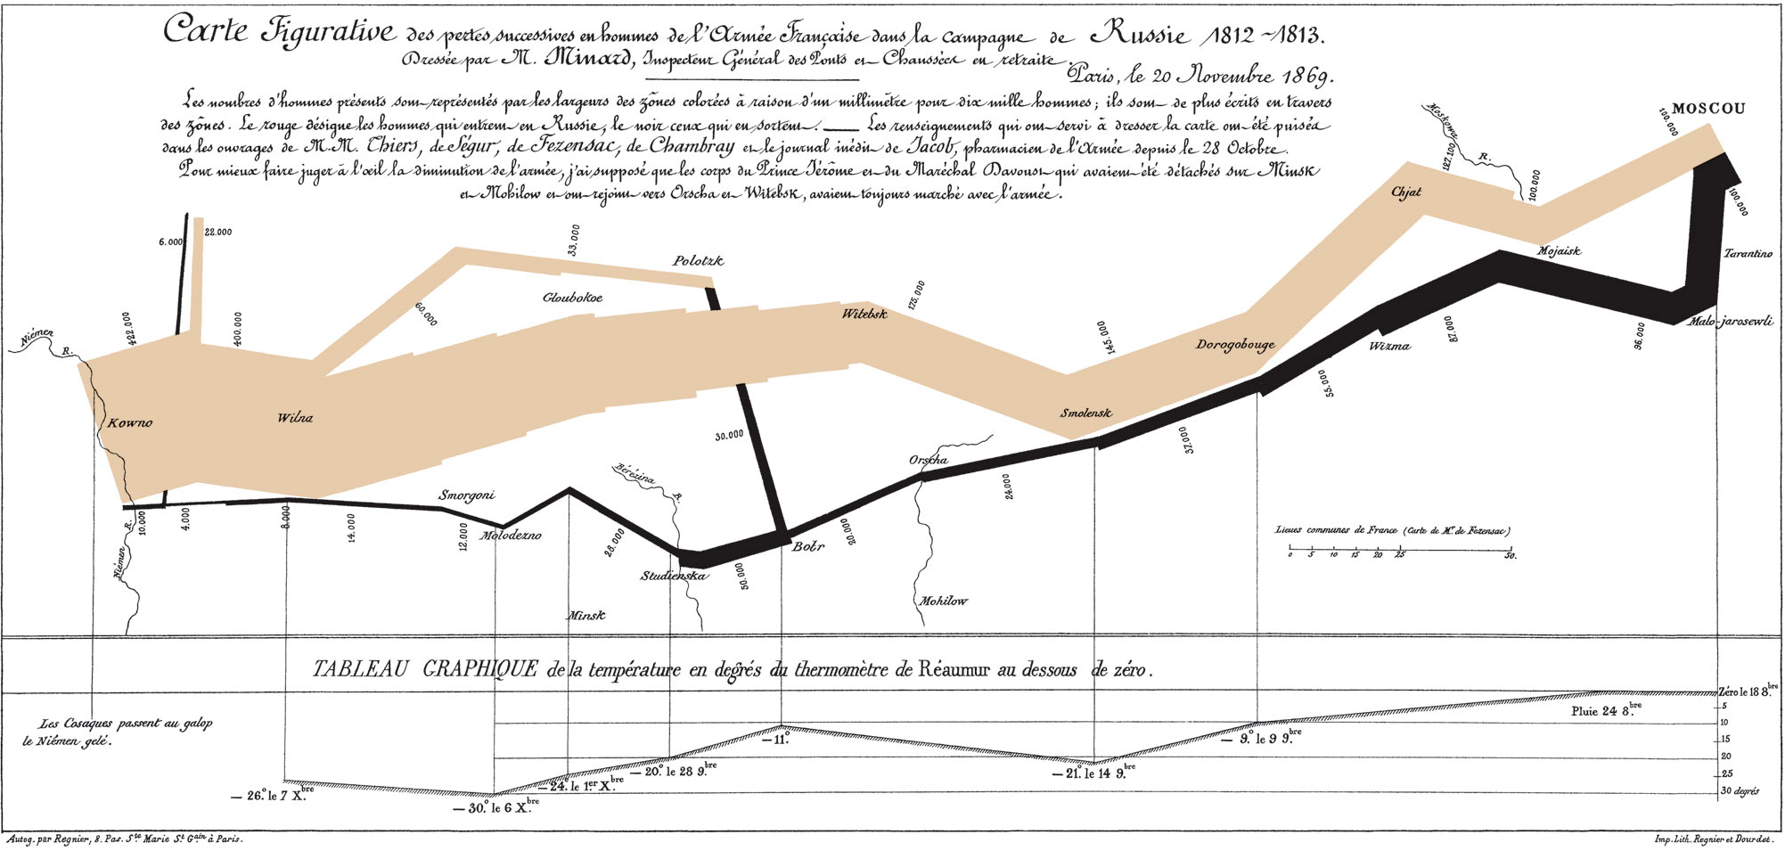
How Many Dimensions of Data?

Slide 10
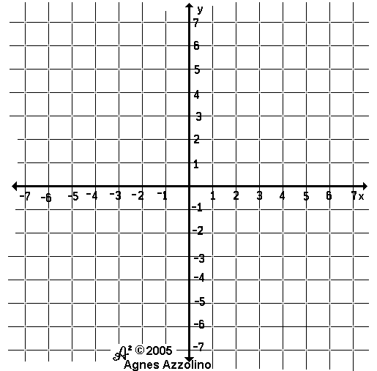
Linear Algebra: So What?
Milk: 2x + y = 10
Cream: 3x + 2y = 16
X = quantity demanded
Y = price

Slide 11
Linear Algebra: So What?
2x + y = 10
3x + 2y = 16
2x + 2y = 14

Slide 12
Linear Algebra: So What?
2x + y = 10

Slide 13
Now The Inverse
Advertising | Sales
2 | 3

Slide 14
Now The Inverse
Advertising | Sales
2 | 3
3 | 5

Slide 15
Now The Inverse
Advertising | Sales
2 | 3
3 | 5
0 | 2

Slide 16


Vectors
Vectors have a magnitude and direction
Usually drawn from origin
$$\left[\begin{matrix}3 \\ 3\end{matrix}\right]$$
$$\left[\begin{matrix}4 \\ −1\end{matrix}\right]$$

Slide 17




Linear Combinations, Span & Basis
Linear combination of vectors:
u =
v =
LC = c₁u + c₂v | c₁, c₂
$$\left[\begin{matrix}3 \\ 3\end{matrix}\right]$$
$$\left[\begin{matrix}4 \\ −1\end{matrix}\right]$$
$$∈$$
$$ℝ$$

Slide 18
A “Good” Basis is Orthonormal!
Means that all basis vectors are both:
Orthogonal
Think “perpendicular”
Normal
Its length is 1

Slide 19
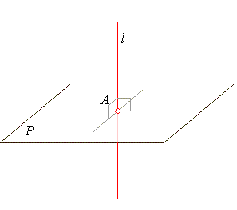
Orthogonality
You’ve been checking for orthogonality all along!
What does a correlation of 0 mean? 1?

Slide 20

Normality
A normal vector has a length of 1
How do you find the length of this line?
x =
||x|| = sqrt(3² + 4²)
This holds true into n-dimensional spaces
4
3
$$\left[\begin{matrix}3 \\ 4\end{matrix}\right]$$

Slide 21




Eigenvectors & Eigenvalues
Eigenvectors are merely scaled during a transformation
The Eigenvalue represents how much it is scaled
Eigenvectors:
or generalized:
Eigenvalues
3 and 1
$$\left[\begin{matrix}1 \\ 1\end{matrix}\right]$$
$$\left[\begin{matrix}−1 \\ 1\end{matrix}\right]$$
$$\left[\begin{matrix}a \\ a\end{matrix}\right]$$
$$\left[\begin{matrix}−b \\ b\end{matrix}\right]$$

Slide 22
Finally… Principal Component Analysis (PCA)!
PCA transforms your data, giving it a new basis
The basis vectors are ranked in order of “information” they contain
The basis vectors are the Eigenvectors
The Eigenvalues represent the “information” or variance
This is a great tool for dimensionality reduction
Datasets can often be reduced from 10+ dimensions to 2 or 3 and only lose a small amount of information

Slide 23
Variation as Information
Age | Gender | # of Accounts | Rewards Tier | Balance
25 | M | 3 | Gold | 10124
24 | F | 3 | Bronze | 1200
24 | M | 3 | Bronze | 0
26 | M | 3 | Platinum | 27833
25 | F | 3 | Silver | 15000

Slide 24
Let’s Explore!

Slide 25
Further Learning
I am woefully unqualified to teach Linear Algebra, so please check out these items if your interest has been piqued:
YouTube series with really cool visualizations and intuitive explanations: https://www.youtube.com/playlist?list=PLZHQObOWTQDPD3MizzM2xVFitgF8hE_ab
edX course that I took some inspiration from: https://courses.edx.org/courses/DavidsonX/D003x.1/1T2015/info
Khan Academy’s Linear Algebra playlist: https://www.khanacademy.org/math/linear-algebra

